Slide 1
“Pandemic” ventilator – V2.0
If a reliable medical air line is available with enough* pressure, then no compressor is needed.
Air system diagram
Pressure
Sensor B
Oxygen
Pressure
Sensor A
Humidifier
Electronic
pressure
Regulator 2
Pressure
Sensor C
Compressor
Air filter
Air regulator
Electronic
pressure
Regulator 1
Flow Meter 1
E-Valve 1
N.C
Patient
E-Valve 2
N.O
CO2
Line denotation
PEEP Valve
Clean air
Contaminated air
UV light
Oxygen
Version: V2.0
Filtering
Notes:
Oxygen input needs to be “flow-positive” into the system.
Design by Marco Mascorro. @Mascobot
Email: m@marcomascorro.com
For educational purposes only.
Use at your own risk.
Joints
ULPA filter
Disclaimer: Non-FDA approved. This product is not intended to diagnose, treat, cure, or prevent any disease.

Slide 2
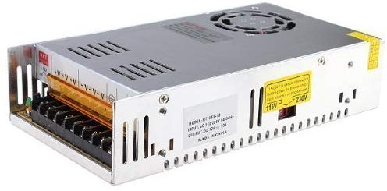
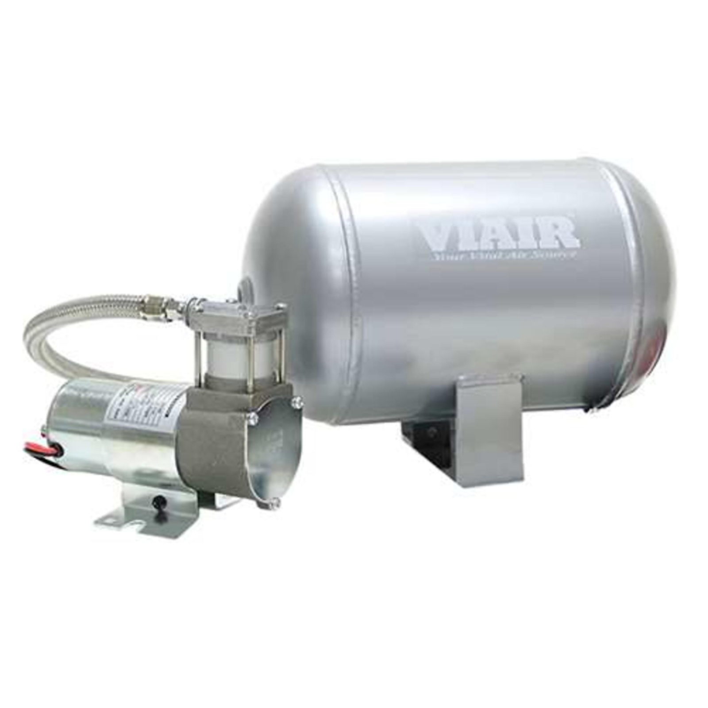

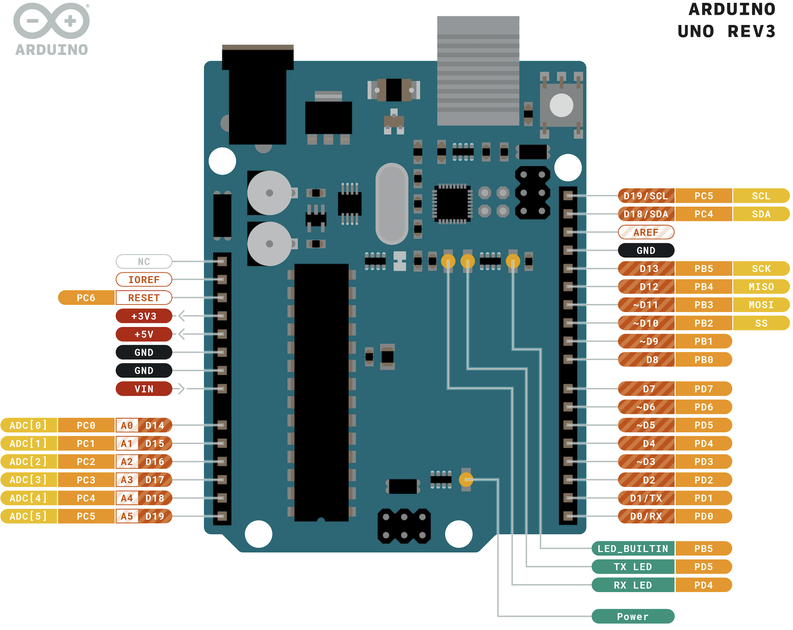

“Pandemic” ventilator – Minimal design
Electric system diagram
12 VDC
Design by Marco Mascorro. @Mascobot
Creative Commons BY-SA license
Email: m@marcomascorro.com
For educational purposes only.
Use at your own risk.

